Slide 1
Representing a multiplicative relationship
Task A: Using double number lines
1) Fill in the blanks.
a)
1
2
3
b)
1
A
A
B
B
4
8
12
3
6
A | B
A | B
For every 1 A, there are Bs.
For every 1 A, there are Bs.
c)
4
6
d)
4
A
A
B
B
14
21
A | B
A | B
2 | 5
For every 1 A, there are Bs.
For every 1 A, there are Bs.
2) Sofia and her dad walk side by side along a straight path. The number of steps are represented by the double number line.
12
8
Which line represents Sofia’s steps?
Explain how you know.
When Sofia has taken 24 steps, how many steps has dad taken?
Write the ratio of Sofia’s steps to her dads steps.

Slide 2
Representing a multiplicative relationship
Task A: Using double number lines
3) Here is a double number line.
Aisha says to find a, she is going to do 5 × 1.5
Andeep says he is going to find one quarter of 30.
Do you agree with Aisha or Andeep? Explain.
10
20
30
A
a
B
5
4) Fill in the blanks.
a)
6
9
b)
30
A
A
B
B
13.5
3
A | B
A | B
For every 1 A, there are Bs.
For every 1 A, there are 0.3 Bs.

Slide 3
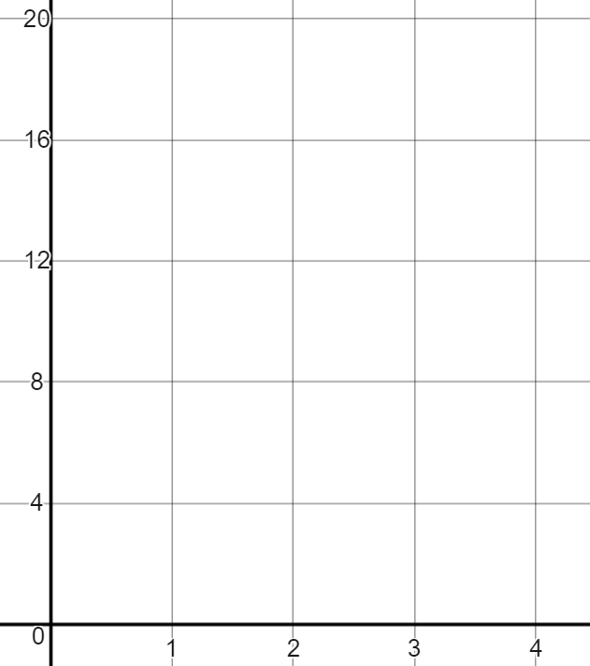
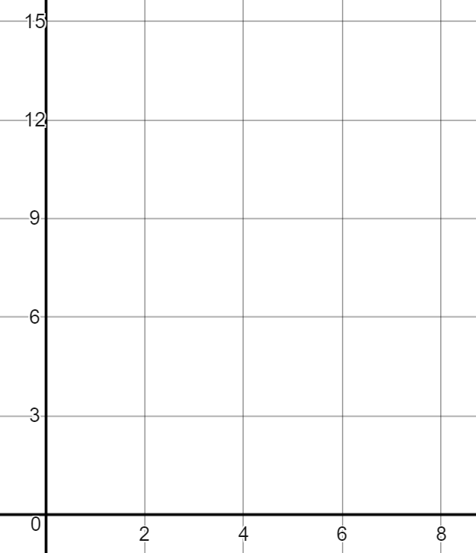
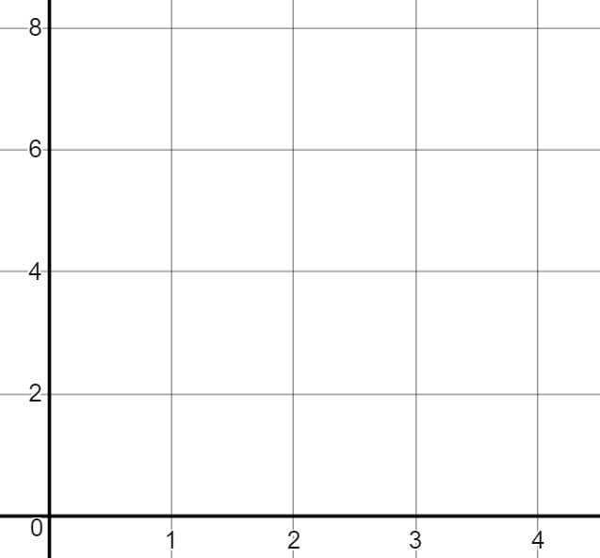
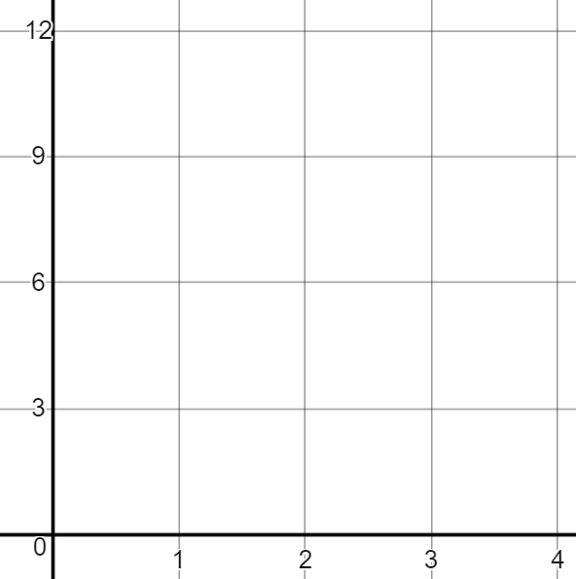
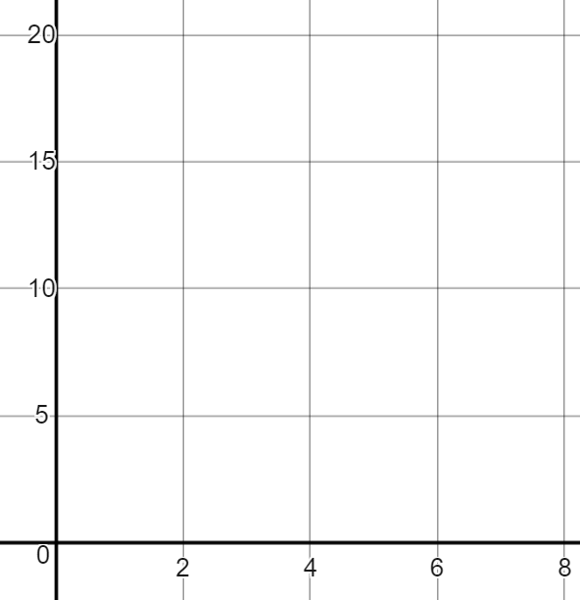
Representing a multiplicative relationship
Task B: Graphical representations
1) Fill in the ratio tables using the corresponding graphs.
B
B
B
A
A
A
A | B
1
A | B
1
A | B
2
2) Fill in the missing information on the double number line of graph.
B
B
B
A
A
A
20
30
B
B
B
A
A
A
1
4
6
12

Slide 4
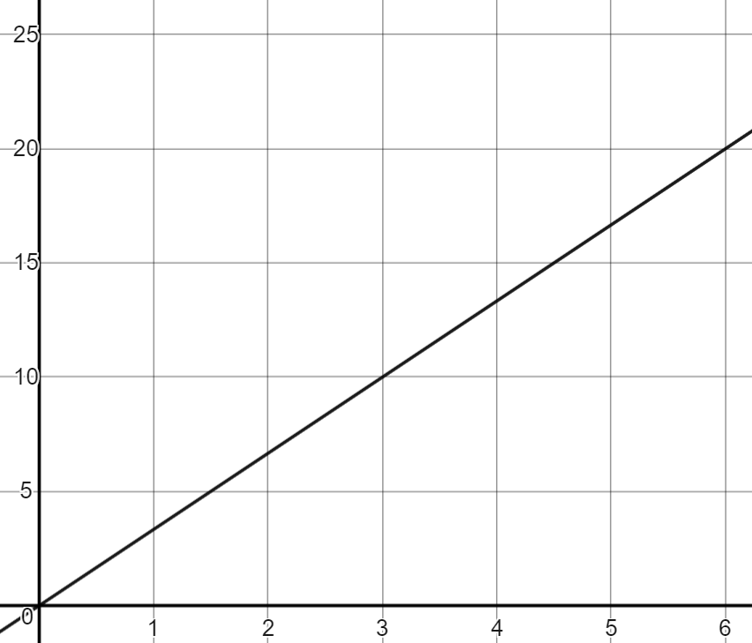
Representing a multiplicative relationship
3) Jacob has interpreted the graph incorrectly.
a) Explain where his mistake is and correctly answer the question.
The double number line is
For every 3 As, there is 1 B
When there are 12 As there are 4 Bs
B
3
6
9
A
1
2
3
B
A
4) Fill in missing information and graph when a scale drawing on a map states for every …….. cm is ……. km in real life.
Work out …….. cm in km
Work out 45 cm in km
Work out …….. km in cm
km
Answer: 40 km
Answer: 150 km
Answer: 18 cm
cm
Mathematics in Education and Industry
v2.3

